Slide 1
Accounting for Managers and Financial Reporting

Slide 2

Session
Objectives
To understand the basics of Accounting
To understand the need of Accounting
To understand the objectives of Accounting
To understand the key terms in accountancy

Slide 3

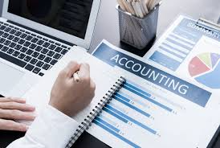
Introduction to Accounting

Slide 4





What is Business?
The term business refers to an organization or enterprising entity engaged in commercial, industrial, or professional activities.
Money invested to earn more money

Slide 5
Basic types of business firms
Proprietorship
Partnership
Corporation
Generally owned by one person.
Often small service-type businesses
Owner receives any profits, suffers any losses, and is personally liable for all debts.
Owned by two or more persons.
Often retail and service-type businesses
Generally unlimited personal liability
Partnership agreement
Ownership divided into shares
Separate legal entity organized under state corporation law
Limited liability

Slide 6
Difference between Public and Private Limited Company
A public company is a company that is listed in the well-known stock exchange and can be traded freely. Where a private limited company is not listed on a stock exchange and it is held privately by the member of the company.
In a private company, it is not mandatory to call a statutory meeting of members, whereas it is mandatory to have a statutory meeting in case of a public limited company.
There must be a minimum of seven members to form and start a public company, on the other side private company has a limit of a minimum of two members to start the business.
There is no capping for the maximum number of members in a public limited company. But a private company cannot have more than 200 members, subject to some conditions.
To start a public company there should be at least 3 directors and is a privately held company, the minimum number of directors should be 2.

Slide 7
The issuance of the prospectus is compulsory in the public limited company and for the private limited company, there is no such instance.
In a private limited company transferability of shares is fully restricted; In contrast, the shareholders of a public limited company can easily and freely transfer their shares.
In a Private Limited Company requires the only certificate of incorporation to start the business, on the other side public company requires a certificate of incorporation and then the certificate of commencement to start a business.

Slide 8
Accounting in Action
What is Accounting?
The Building Blocks of Accounting
The Basic Accounting Equation
Using the Accounting Equation
Financial Statements
Three activities
Who uses accounting data?
Ethics in financial reporting
Accounting standards
Assumptions
Assets
Liabilities
Equity
Transaction analysis
Summary of transactions
Income statement
Retained earnings statement
Statement of financial position
Statement of cash flows

Slide 9

What is Accounting?
The purpose of accounting:
to identify, record, and communicate the economic events of an
organization to
interested users.

Slide 10
Definition of Accounting
“ the art of recording, classifying and summarizing in a significant manner and in terms of money transactions and events which are, in part at least, of a financial character, and interpreting the results thereof ”
-American Institute of Certified Public Accountants
“ the process of identifying, measuring and communicating economic information to permit informed judgements and decisions by users of the information”
-American Accounting Association

Slide 11
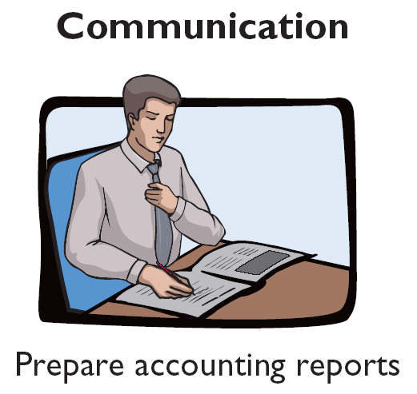
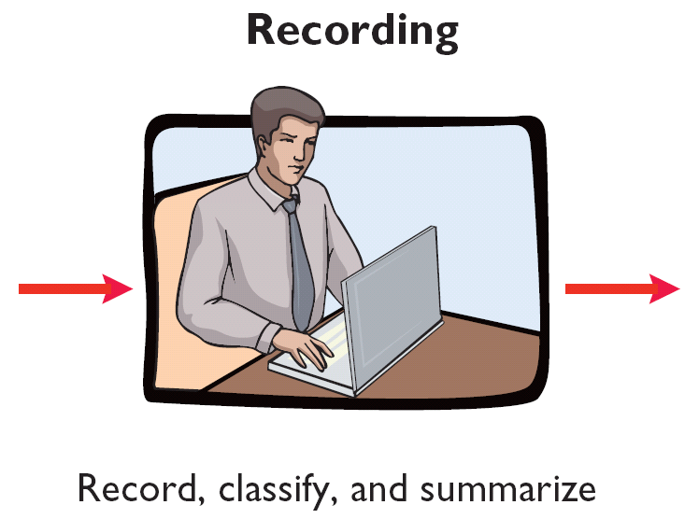
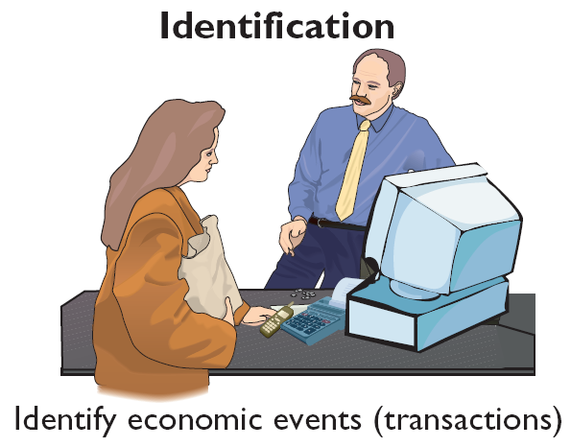
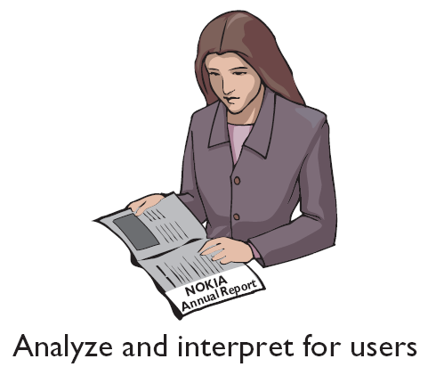
What is Accounting?
Three Activities
The accounting process includes
the bookkeeping function.

Slide 12
Who Uses Accounting Data?
Internal Users
External Users
Regulatory
Agencies
Labour Unions
Owner
Employees
Tax
Authorities
Creditors
Management
Customers
Investors

Slide 13

What are they looking for in Accounting Data and Why?
Management
Shareholders
Investors
Suppliers
Banks and Financial Institutions
Customers/Buyers
Government Agencies
Employees
Public

Slide 14






What are they looking for in Accounting Data and Why?
Employees
Management
HR professionals
Lenders

Slide 15
Common Questions Asked
User
1. Can we afford to give our employees a pay raise?
Human Resources
2. Did the company earn a satisfactory income?
Investors
Should any product lines be eliminated?
Management
4. Is cash sufficient to pay dividends to shareholders?
Finance
5. What price for our product will maximize net income?
Marketing
6. Will the company be able to pay its debts?
Creditors

Slide 16
Important Questions
  Managers, shareholders, creditors and other interested groups seek answers to the following important questions about a firm:
    What is the financial position of the firm at a given point of time?
    How has the firm performed financially over a given period of time?
    What have been the sources and uses of cash over a period of time?
    What is the character of Income & Expenditure?
    What is the quality of Assets and nature of Liabilities?
    What are various factors affecting Incomes and expenditures in past and how these factors are going to behave in future?
    What are the other external factors which may affect the financial position of the firm?
The accountant prepares the balance sheet, the profit and loss account, and the statement of cash flows to answer the above questions
16

Slide 17
Classification of Accounting
Accounting
Cost Accounting
Financial Accounting
Management Accounting

Slide 18
Objectives of Accounting
To access the business profit or loss
To ascertain the financial position
To protect the business Assets
To keep the systematic records
To facilitate rational decision making

Slide 19
Definition of Accounting (repeated)
“ the art of recording, classifying and summarizing in a significant manner and in terms of money transactions and events which are, in part at least, of a financial character, and interpreting the results thereof ”
-American Institute of Certified Public Accountants
“ the process of identifying, measuring and communicating economic information to permit informed judgements and decisions by users of the information”
-American Accounting Association

Slide 20

What is transaction?
Purchase
Sale
Or Exchange of
Goods and/or Services
Between two of more parties
To be recorded in Accounting records, the firm must be one of the parties in the transaction

Slide 21
Five important heads to understand
Income : money what an individual or business receives in exchange for providing labour, producing a good or service, or through investing capital.
For a particular period : from beginning date to ending date
Expenses: spending of money on something, or the money that is spent on something.
Assets: economic resources owned by firm to generate future income or can be converted into cash or equivalent.
As on particular date
Liabilities: amount owed by the firm
Capital: Money invested by the owners

Slide 22


